Slide 1



HTML and CSS Basics
HTML Basic Tags, CSS Introduction
SoftUni Team
Technical Trainers
Software University
https://softuni.bg

Slide 2
Table of Contents
What is HTML?
HTML Page
HTML Developer Elements
HTML Common Elements
Headings, Paragraphs, Hyperlinks, Images
Ordered and Unordered Lists
What is CSS?
External, Internal and Inline CSS Style
Notes:
The plan for this lesson is as follows:
I will start with some basic HTTP protocol concepts: the request-response model, front-end and back-end interaction, and the client-server model.
I will show you some powerful tool for HTTP developers: the HTTP traffic monitoring tool in the Chrome Web browser and the Postman HTTP testing tool.
I will explain how HTML forms submit data using the GET and POST methods of the HTTP request.
Then, we shall focus on the HTTP requests: the request method, the request headers and the request body.
I will explain in detail the HTTP responses: the response status codes, the response headers and the response body.
Finally, we shall discuss the structure of the URL addresses for locating resources on the Web, which is used together with the HTTP protocol.

Slide 3
Have a Question?
sli.do
#fund-common

Slide 4
What is HTML?

Slide 5

What is HTML?
The HTML language describes Web content (Web pages)
Text with formatting, images, lists, hyperlinks, tables, forms, etc.
Uses tags to define elements in the Web page
Opening tag
<p>
<b>Document</b> content goes here…
</p>
Element
Closing tag

Slide 6
HTML – Developer Environments
WebStorm
Powerful IDE for HTML, CSS and JavaScript, paid product
Visual Studio
Many languages and technologies, Windows & Mac
Visual Studio Code, Brackets, NetBeans
Good free tools for HTML5, cross-platform

Slide 7
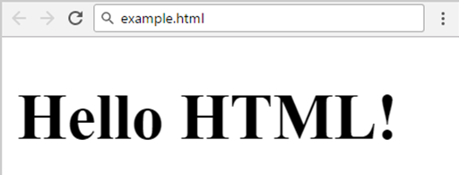
HTML Page – Example
<!DOCTYPE html>
<html>
<head>
<meta charset="UTF-8">
<title>HTML Example</title>
</head>
<body>
<h1>Hello HTML!</h1>
</body>
</html>

Slide 8
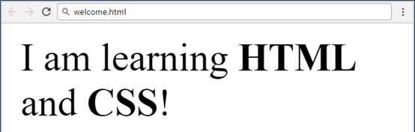
Problem: Welcome to HTML
Create your first HTML page
File name: welcome.html
Title: Welcome
Paragraph of text: I am learning HTML and CSS!
Hints:
Modify the code from the previous slide, use <strong> tag

Slide 9
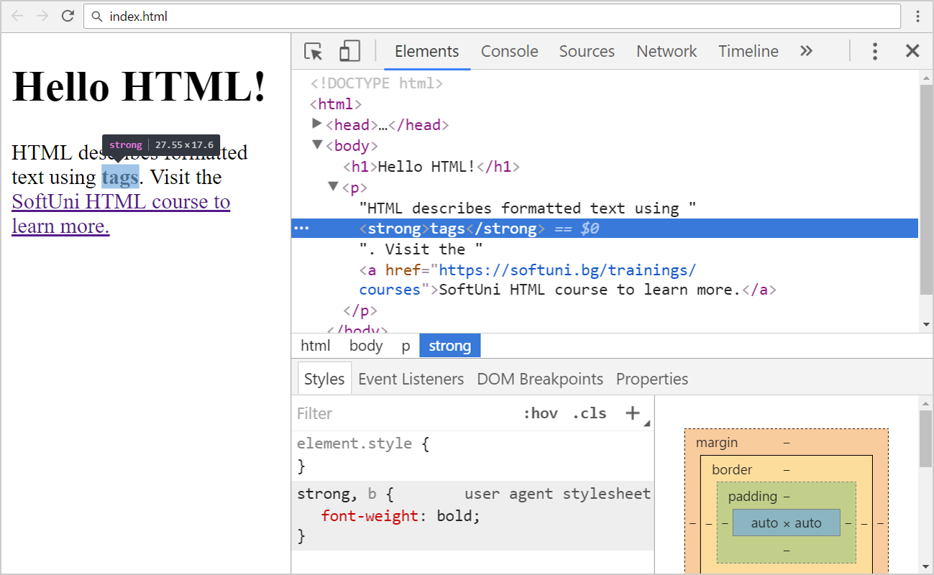
Developer Tools: [F12] in the Browser

Slide 10

HTML Common Elements

Slide 11
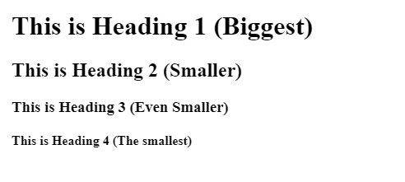
Headings
Headings: <h1> to <h6>
<h1>This is Heading 1 (Biggest)</h1>
<h2>This is Heading 2 (Smaller)</h2>
<h3>This is Heading 3 (Even Smaller)</h3>
<h4>This is Heading 4 (The smallest)</h4>
11

Slide 12
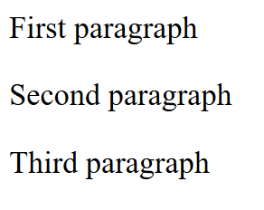
Paragraphs
Paragraphs: <p></p>
<p>First paragraph</p>
<p>Second paragraph</p>
<p>Third paragraph</p>
12

Slide 13

Hyperlinks
Specify the URL
Absolute hyperlink
HTML hyperlink
Relative hyperlink
<a href="https://softuni.bg">SoftUni</a>
<h1 id="exercises">Exercises</h1>
…
See the <a href="#exercises" target="_blank">exercises</a>
<a href="../2.%20HTML5-Overview.pptx">presentation</a>

Slide 14

Images
Images are external files, inserted through the <img> tag
<img src="images/SoftUni-logo.png" />
14

Slide 15
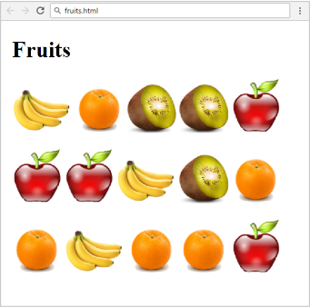
Problem: Fruits
You are given 4 images files:
apple.png, banana.png, kiwi.png, orange.png
Create a web page like the screenshot on the right
Use 3 paragraphs - each holding 5 images

Slide 16
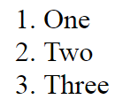
Ordered Lists
Create an Ordered List
Use <ol></ol>
Each holding <li></li>
<ol>
<li>One</li>
<li>Two</li>
<li>Three</li>
</ol>
16

Slide 17
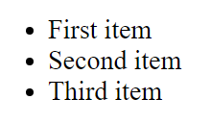
Unordered Lists
Create an Unordered List using <ul></ul>:
Each holding <li></li>
<ul>
<li>First item</li>
<li>Second item</li>
<li>Third item</li>
</ul>
17

Slide 18
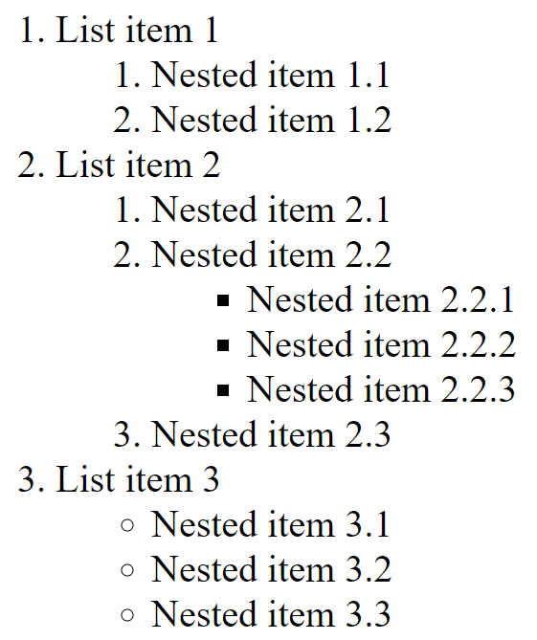
Problem: HTML Lists
Create a HTML page, holding nested lists, like the example:

Slide 19
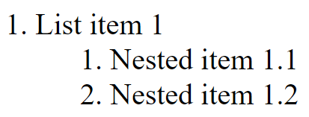
Solution: HTML Lists
<ol>
<li>List item 1
<ol>
<li>Nested item 1.1</li>
<li>Nested item 1.2</li>
</ol>
</li>
<!-- TODO: put List item 2 and List item 3 here -->
</ol>

Slide 20
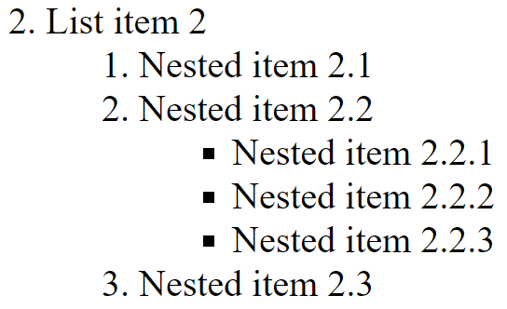
Solution: HTML Lists (2)
<li>List item 2
<ol>
<li>Nested item 2.1</li>
<li>Nested item 2.2
<ul>
<li>Nested item 2.2.1</li>
<!-- TODO: put the next items here-->
</ul>
</li>
<li>Nested item 2.3</li>
</ol>
</li>

Slide 21
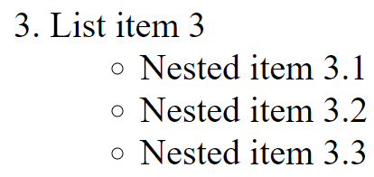
Solution: HTML Lists (3)
<li>
List item 3
<ul>
<li>Nested item 3.1</li>
<!-- TODO: put the next items here -->
</ul>
</li>

Slide 22
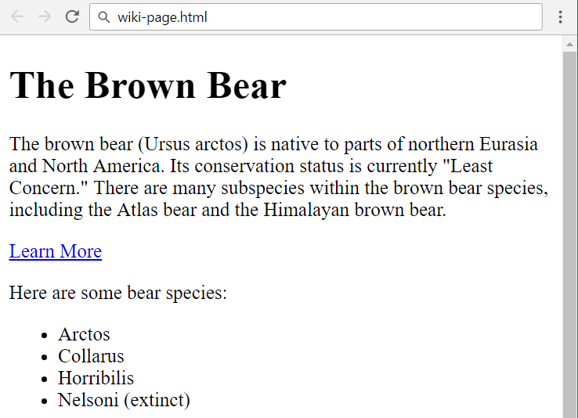
Problem: Wiki Page
Create the following HTML page:

Slide 23
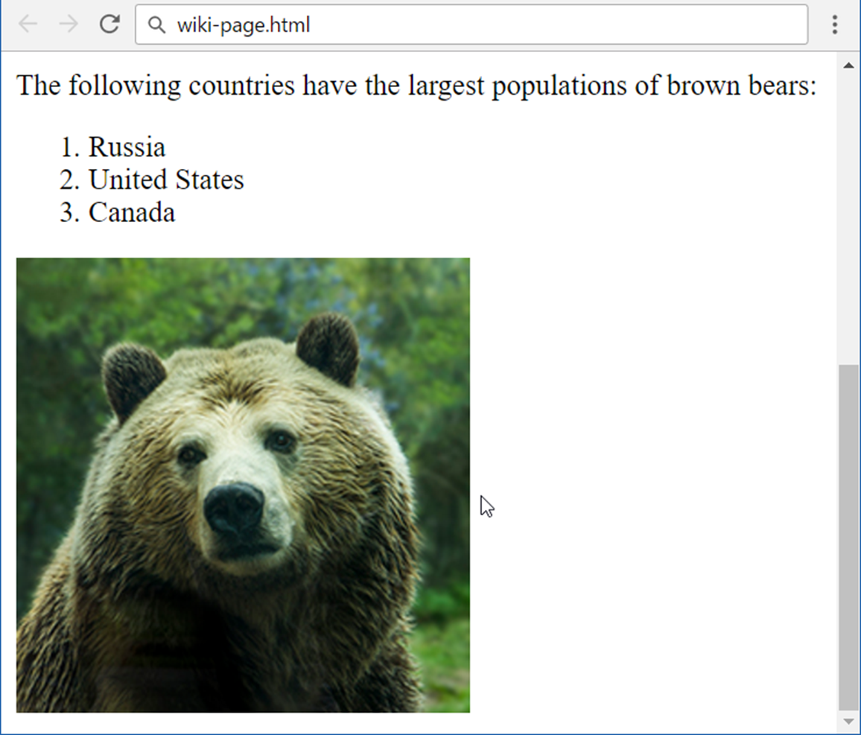
Problem: Wiki Page (2)
Create the following HTML page:

Slide 24
What is CSS?

Slide 25
What is CSS?
CSS defines styling of the HTML elements
Specifies fonts, colors, margins, sizes, positioning, floating, …
CSS rules format: selector { prop1:val1; prop2:val2; … }
CSS rule example:
h1 {
font-size: 42px;
color: yellow;
}
Selector
Declaration
Property
Value

Slide 26
Combining HTML and CSS Files (External Style)
using-css.html
styles.css
<!DOCTYPE html>
<html>
<head>
<link rel="stylesheet" type="text/css" href="styles.css">
</head>
<body>
</body>
</html>
/* CSS here */

Slide 27
Element Selector
Selects all elements with the specified element name
Style all headings:
Adding more white space after each paragraph:
h1 { text-align: center; color: #000; }
p { padding-bottom: 15px; }
27

Slide 28
Class Selector
Uses the HTML class attribute, and is defined with a "."
Only one HTML tag can be specified to be affected by a class
.class { text-align: center; }
<h2 class="class">…</h2>
p.right { text-align: right; }

Slide 29
Id Selector
The #id selector styles the element with the specified id
Uses the id attribute of the HTML element
Defined with a "#" in the CSS
<h1 id="header">My Header</h1>
#header { border: 1px solid #CCC; border-width: 1px 0; }

Slide 30
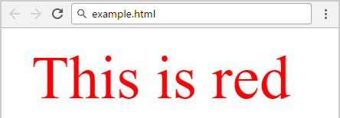
Internal Style Sheet
Put a <style> element in the HTML <head> section
<!DOCTYPE html>
<html>
<head>
<style>
.red {
color:red;
}
</style>
</head>
</html>
<body>
<p class="red">This is red</p>
</body>

Slide 31
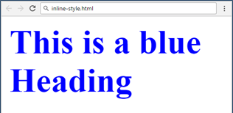
Inline CSS Style
The style attribute in HTML elements
Attribute "style"
<h1 style="color:blue">This is a blue heading</h1>
Property
Value

Slide 32
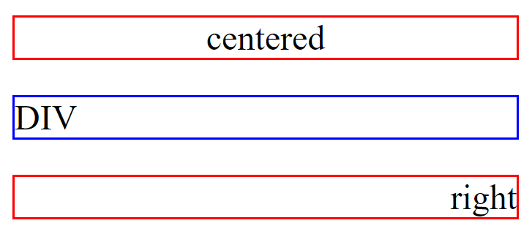
Block Elements
<div> and <p> are block elements (rectangles)
Fill the entire container width
Stack vertically one after another
display: block

Slide 33
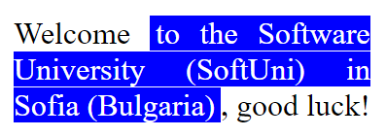


Inline Elements
<span> is an inline element
Its shape is not always rectangular
Can be split across multiple lines
display: inline

Slide 34
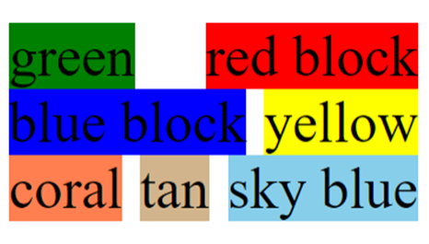
Inline-Block Elements
Elements can be also inline-block
Rectangles arranged one after another
Just like words in a sentence
display: inline-block

Slide 35
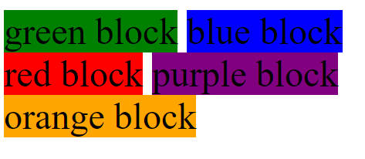
Problem: Color Blocks
Use the following HTML and style it as the screenshot:
<div class="green">green block</div>
<div class="blue">blue block</div>
<div class="red">red block</div>
<div class="purple">purple block</div>
<div class="orange">orange block</div>

Slide 36
Solution: Color Blocks
div {
display: inline-block;
}
.green {
background-color: green;
}
.blue {
background-color: blue;
}
<!-- Implement rest of the styles -->

Slide 37

Summary
HTML describes structures content
Text, images, tables, figures, etc.
CSS describes how HTML elements should be displayed
Styles may be: external, internal and inline
Notes:
37

Slide 38









Questions?

Slide 39












SoftUni Diamond Partners

Slide 40

Educational Partners

Slide 41

License
This course (slides, examples, demos, exercises, homework, documents, videos and other assets) is copyrighted content
Unauthorized copy, reproduction or use is illegal
© SoftUni – https://softuni.org
© Software University – https://softuni.bg
Notes:
41

Slide 42
Trainings @ Software University (SoftUni)
Software University – High-Quality Education, Profession and Job for Software Developers
softuni.bg, softuni.org
Software University Foundation
softuni.foundation
Software University @ Facebook
facebook.com/SoftwareUniversity
Software University Forums
forum.softuni.bg
42
Notes:
42

